Slide 1
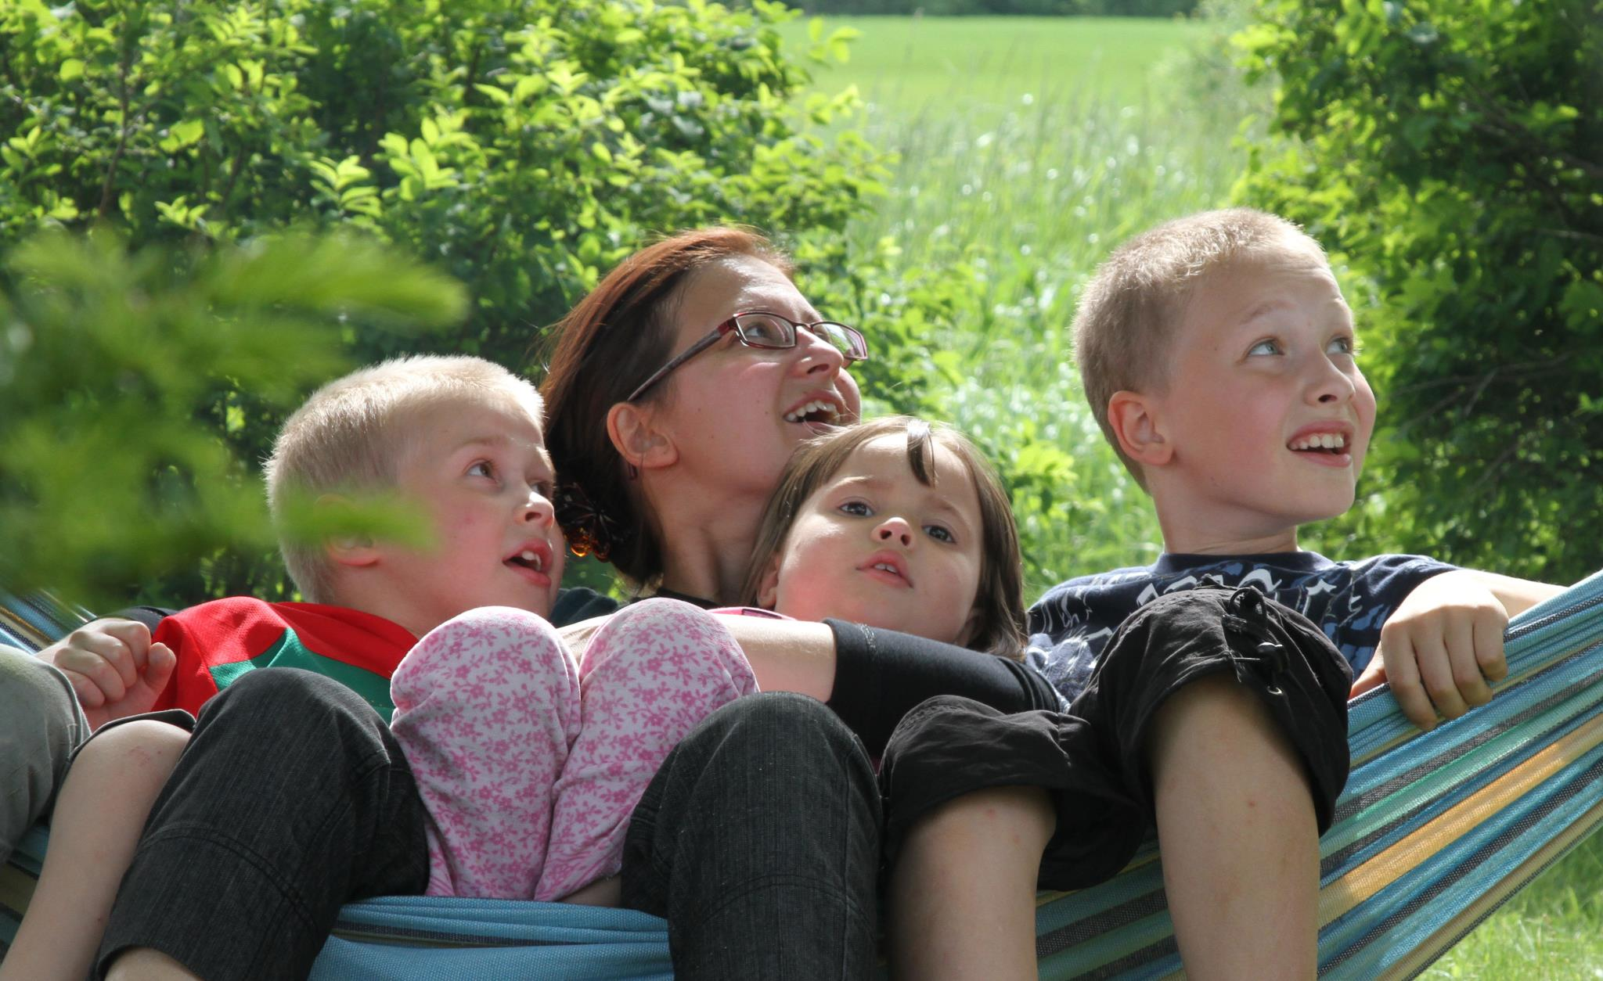
Towards a physically more active lifestyle based on one´s own values: the results of a randomized controlled trial among physically inactive adults
Anu Kangasniemi, Raimo Lappalainen, Anna Kankaanpää, Asko Tolvanen ja Tuija Tammelin
LIKES Research center for sport and health sciences, University of Jyväskylä, Finland

Slide 2
Introduction
Picture KKI-Program: Studio Juha Sorri

Slide 3
Behavioural interventions have been shown to have only a small to moderate effect on self-reported physical activity levels.
The interventions which are theory-based and include techniques like self-monitoring, using feedback and goal-setting seemed to be more effective than the other type of interventions.
Physical activity interventions lack of coherent clinical behaviour change models, which can explain how the changes will occur and evidence based methods, which support especially the maintenance of changes.
New approaches, theories and methods are needed.

Slide 4
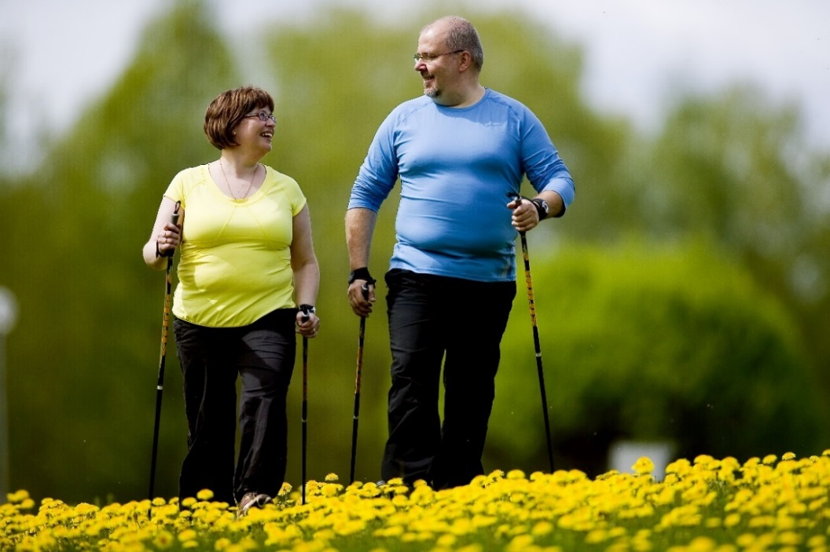
Aim of the study
Enhance physically more active lifestyle among physically inactive adults by applying Acceptance and Commintment Therapy.
Picture KKI-Program: Studio Juha Sorri

Slide 5
This study aimed to investigate the effectiveness of the feedback only (FB) versus the combination of acceptance- and commitment-based group intervention, including self-monitoring of physical activity and feedback (ACT+FB)
1) on physical activity
2) on the cognitions related to exercise and physical activity among physically inactive adults.
A further aim was to explore the stability of individual changes in physical activity between the groups.

Slide 6
Eligible participants (N=138)
Randomization
Feedback group, FB
(N=69)
Acceptance
and Commitment based group, ACT+FB (N=69)
Baseline measurements
Baseline measurements
6 group sessions
3 and 6 month follow-up
3 and 6 month
follow-up
Notes:
Kontrolliryhmä+ ACT-ryhmä
-> kirjallinen palaute omasta fyysisestä aktiivisuustasostaan ja mahdollisuus osallistua kehonkoostumusanalyysiin

Slide 7
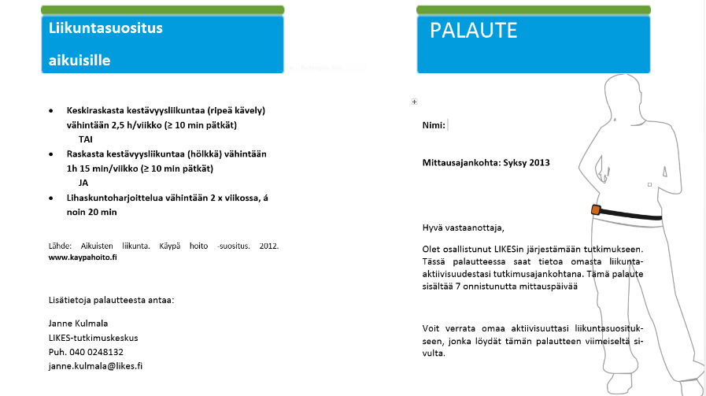
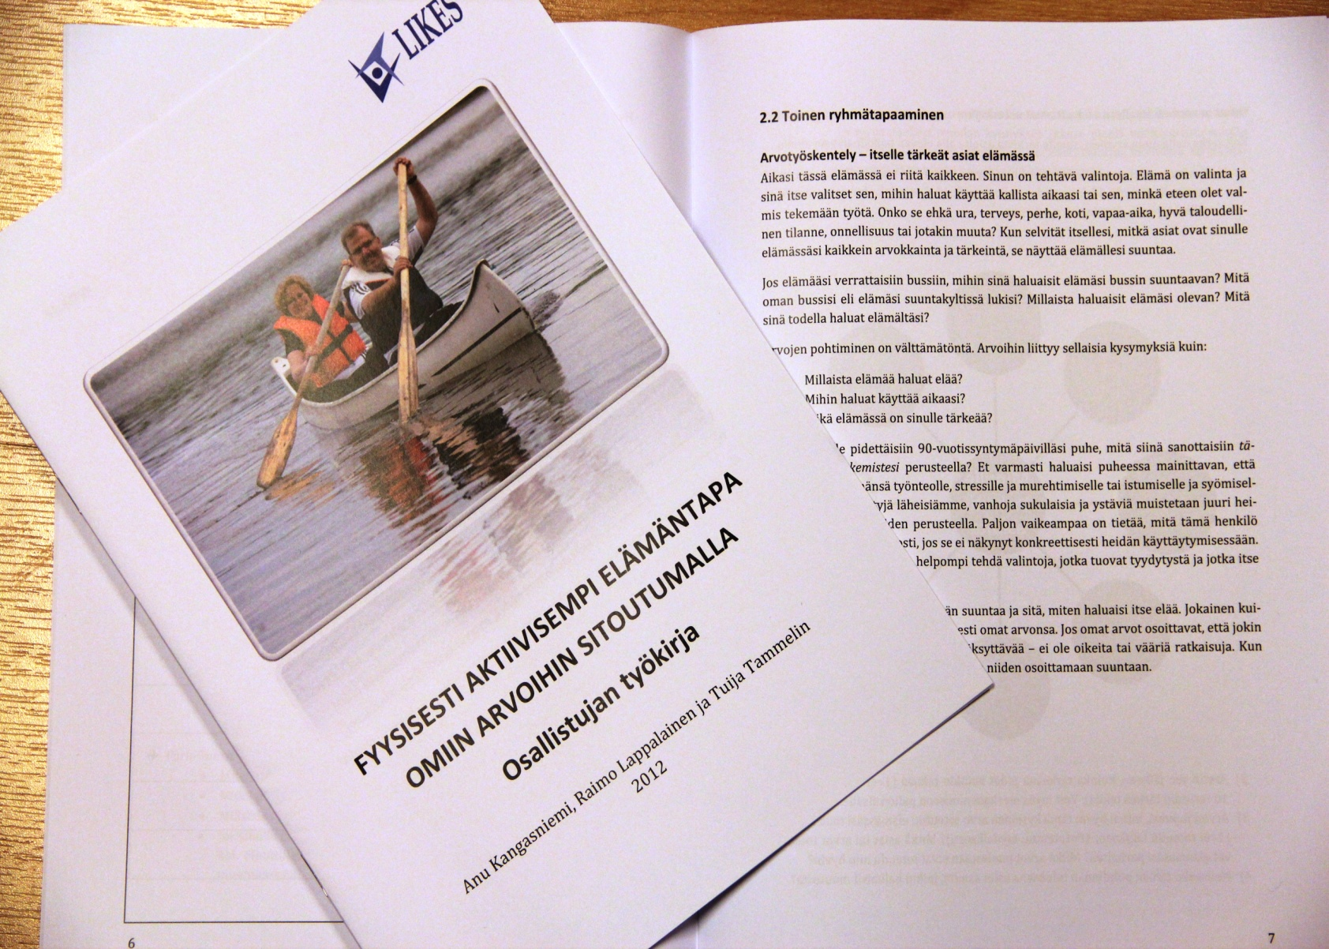
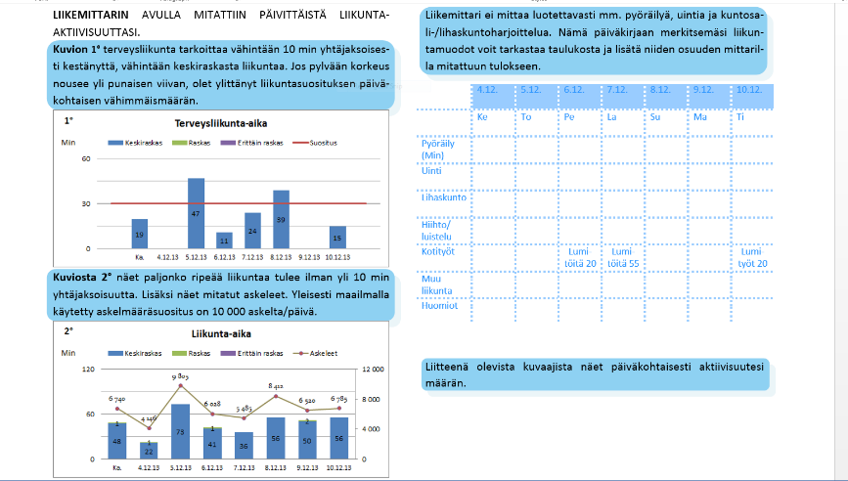
Interventions
Feedback group, FB
The Acceptance and Commitment-based group, ACT+FB

Slide 8
Content of the 6 group sessions in ACT+FB group
Topics/session | Aim/the key points
1. Health Behavior | what are the factors that affect my health behavior/wellbeing
2. Values and important things in the life | What are important values for me? Am I living/behaving according to my values?
3. Value based actions and working with the barriers | to define specific goals and actions in the service of valued behavior. What kind of subjective barriers or explanations I have related to physical activity?
4. Living in the present moment and mindfulness-skills | how to contact the present moment how to use mindfulness-skills in order to be more aware of own behavior in the everyday life
5. Self as a physical activity context and social support | how you see yourself and how that affects to your behavior
6. Flexibly forward | to re-evaluate the learning process, set goals and values. Can I be more flexible related to my physically active lifestyle?
Notes:
Every session included:
- mindfulness exercise
- pair/group discussions
- homework between the sessions
Varied number of defusion exercises and metaphors

Slide 9
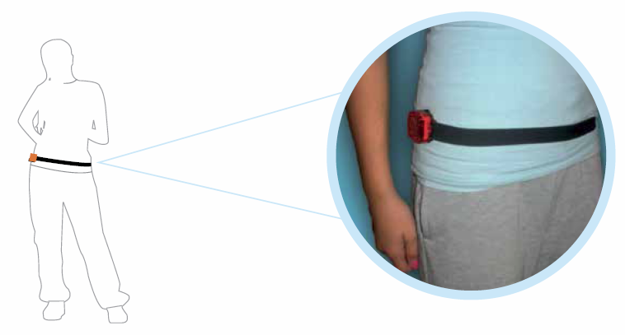
Measurements
Physical activity:
ActiGraf:
Health enhancing physical activity, HEPA-time
Moderate-to-vigorous physical activity, MVPA-time
- Self-reported physical activity
2. Cognitions to physical activity and exercise:
Adoption self-efficacy
Self-efficacy related to barriers
Action and coping planning
Acceptance of psychological and physical discomfort related to physical activity
(PA-AAQ)
3. Depression:
Beck´s Depression Inventory, BDI-II
Notes:
Kontrolliryhmä+ ACT-ryhmä
-> kirjallinen palaute omasta fyysisestä aktiivisuustasostaan ja mahdollisuus osallistua kehonkoostumusanalyysiin

Slide 10
Statistical analysis
Data were analyzed using the Mplus statistical package 7.1
The intervention effect on objectively measured physical activity, as well as on secondary outcome variables, was examined between baseline (t1) and three-month follow-up (t2) and between baseline and six-month follow-up (t3).
Mean change in ACT+FB and FB groups and the difference in the mean change between the groups was estimated and tested for significance by using multiple-group analysis method and model constraint feature in Mplus (z-test for differences).
Furthermore, differences in the stability of physical activity (PA) between the ACT+FB and FB groups were examined in objectively measured and self-reported physical activity by using path model and regression coefficients.

Slide 11
 | FB group (n=60) |  |  | ACT+FB group (n=64) |  |  | p-value
 | % | Mean (sd) |  | % | Mean (sd)
Age |  | 43.0 (5.3) |  |  | 43.9 (4.8) |  | 0.338
Women | 85.0 |  |  | 79.7 |  |  | 0.439
Body mass index |  | 27.9 (4.9) |  |  | 29.4 (5.7) |  | 0.116
<25 (normal weight) | 33.3 |  |  | 24.2
25-30 (overweight) | 38.3 |  |  | 29.0
>30 (obese) | 28.3 |  |  | 46.8 |  |  | 0.110
Depression (BDI≥14) | 11.7 |  |  | 25.0 |  |  | 0.056
Diagnosed
mental health problems | 18.3 |  |  | 24.1 |  |  | 0.440
Diagnosed other physical problems | 36.7 |  |  | 41.4 |  |  | 0.600

Slide 12
Results: Physical activity
Health enhancing time: T1 vs T3, p=0.55

Slide 13
Results: Cognitions related to physical activity and exercise
In the ACT+FB group cognitions related to physical activity and exercise improved more compared to the changes in the FB group.
- Adoption self-efficacy
- Barriers self-efficacy
- Action and coping planning
- The acceptance of psychological and physical discomfort (PA-AAQ)

Slide 14
Results: Stability in physical activity behaviour
The path models were fitted for three physical activity measures, HEPA time, MVPA time, and self-reported physical activity.
Path models showed a higher rank-order stability for the ACT+FB group between 3 months and 6 months follow-up than for the FB group.
However, further analysis showed that there was no statistical difference in the individual stability between the groups.

Slide 15
Results: Physical activity behavior among non-depressed participants (BDI-II<14) (FB: n=53; ACT+FB: n=48)
The change in mean levels of physical activity:
The change in the mean levels increased between the groups, but no difference was observed between the FB and ACT+FB groups in the change of HEPA time (t1 vs. t3: p=0.08), MVPA time (t1 vs. t3: p=0.43), or self-reported physical activity (t1 vs. t3: p=0.64).
Stability of the physical activity behaviour:
The test of equality of each regression coefficient showed a significant difference in regression coefficients between the FB and ACT+FB groups between t2 and t3 (b=-0.04 vs. b=0.51, p=0.001)

Slide 16
Stability of health enhancing physical activity
among non-depressed participants
FB (n=53)
.245 (.142) n.s.
-.044 (.113) n.s.
HEPA time
Baseline
HEPA time
3 months
HEPA time
6 months
.735 (.058) ***
ACT + FB (n=48)
.215 (.192) n.s.
.509 (.159)**
HEPA time
Baseline
HEPA time
3 months
HEPA time
6 months
.165 (.199) n.s.

Slide 17
Conclusions
Acceptance- and commitment-based group intervention combined with self-monitoring of physical activity was not superior in increasing physical activity mean levels, but brought more stability to the individual level physical activity behaviour change, especially among the non-depressive participants.
ACT based intervention was also beneficial in supporting the change of cognition related to exercise and physical activity.
Providing only feedback on one’s physical activity level may increase physical activity at group level in the short term, but this improvement seems to be maintained at the individual level only temporarily.

Slide 18
Conclusions
Values-, mindfulness skills- and acceptance emphasizing approaches may bring more needed individual stability to the lifestyle changes, which is important to decrease the ”pendulum” effect.
The ACT approach may be especially useful for the physically inactive participants, because even the little lifestyle changes are important for the health, if these changes are maintained in the long run.

Slide 19
Thank you!

